Slide 1
Magi Market Store Promotion
Eva Burns
Brooklyn Johnson

Slide 2
When asked to create a promotion for an item in the school store, what would your response be?
“How about lets sell those Naked Smoothies, but… with a twist!”

Slide 3
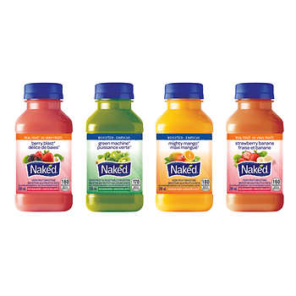
Naked Smoothie
We offer four flavors of Naked Juice
~Berry Blast
~Green Machine
~Mighty Mango
~Strawberry Banana

Slide 4
Pricing….
Currently
Sales Pricing
We sell individual juices for $1.75 to our consumers
We buy the juices for $1.40 each
Our general profit from each juice is $0.35
On sale our product would be 2 for $3 or $1.50 each
We still would buy the juices for $1.40
Our general profit from each juice while on sale would be $0.10

Slide 5

2 FOR $3.00? That’s a juice for you and me!
Come to the Magi Market for GREAT deals!!!
Purchase a total of two (2) naked brand juices for $0.50 off original price
Offer Only Valid
2/6/18 – 2/20/18

